Slide 1

MODCOM INSTITUTE OF TECHNOLOGY PROJECT

Slide 2
NAME : elvis odhiambo
Project Name: Gateway Travel Agency stems

Slide 3
Problem definition/Need
The beginning of Gateway Travel Agency system from identifying key pain points in traditional travel booking processes. The Bulky booking actions, lack of transparency, and limited customization options were among the challenges faced by travelers. Moreover, disparate sources of information often led to confusion and disappointment. Recognizing these issues as opportunities for advance, Gateway set out to streamline the booking experience, enhance transparency, and empower travelers with personalized solutions.

Slide 4
Solution
Compete with online agencies:
Streamlined booking experience – by developed a user-friendly platform that simplifies the booking process, making it easier for travelers to plan their trips. The platform integrates all necessary steps, such as flight and hotel booking, car rental, and activity reservations, into a single interface. This reduces the complexity and time required for travelers to plan their trips.
Enhanced transparency -The platform provides transparent pricing and clear information about the services offered. This helps travelers make informed decisions and avoid hidden fees or unexpected charges.
Personalized solutions - Gateway Travel Agency leverages AI and machine learning algorithms to analyze user preferences and offer personalized recommendations. This empowers travelers to create customized itineraries tailored to their interests, budget, and travel style.
Centralized information – The platform sums information from various sources, such as airlines, hotels, and tour operators, to provide a single source of truth for travelers. This eliminates the need for travelers to search multiple websites for information, reducing confusion and frustration.

Slide 5
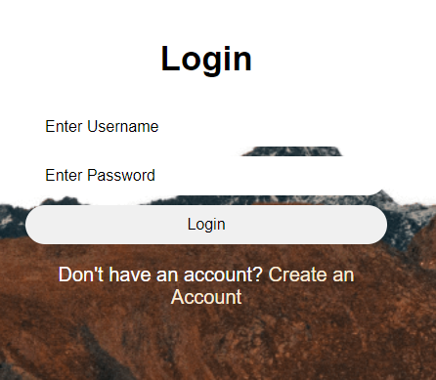
My login design

Slide 6
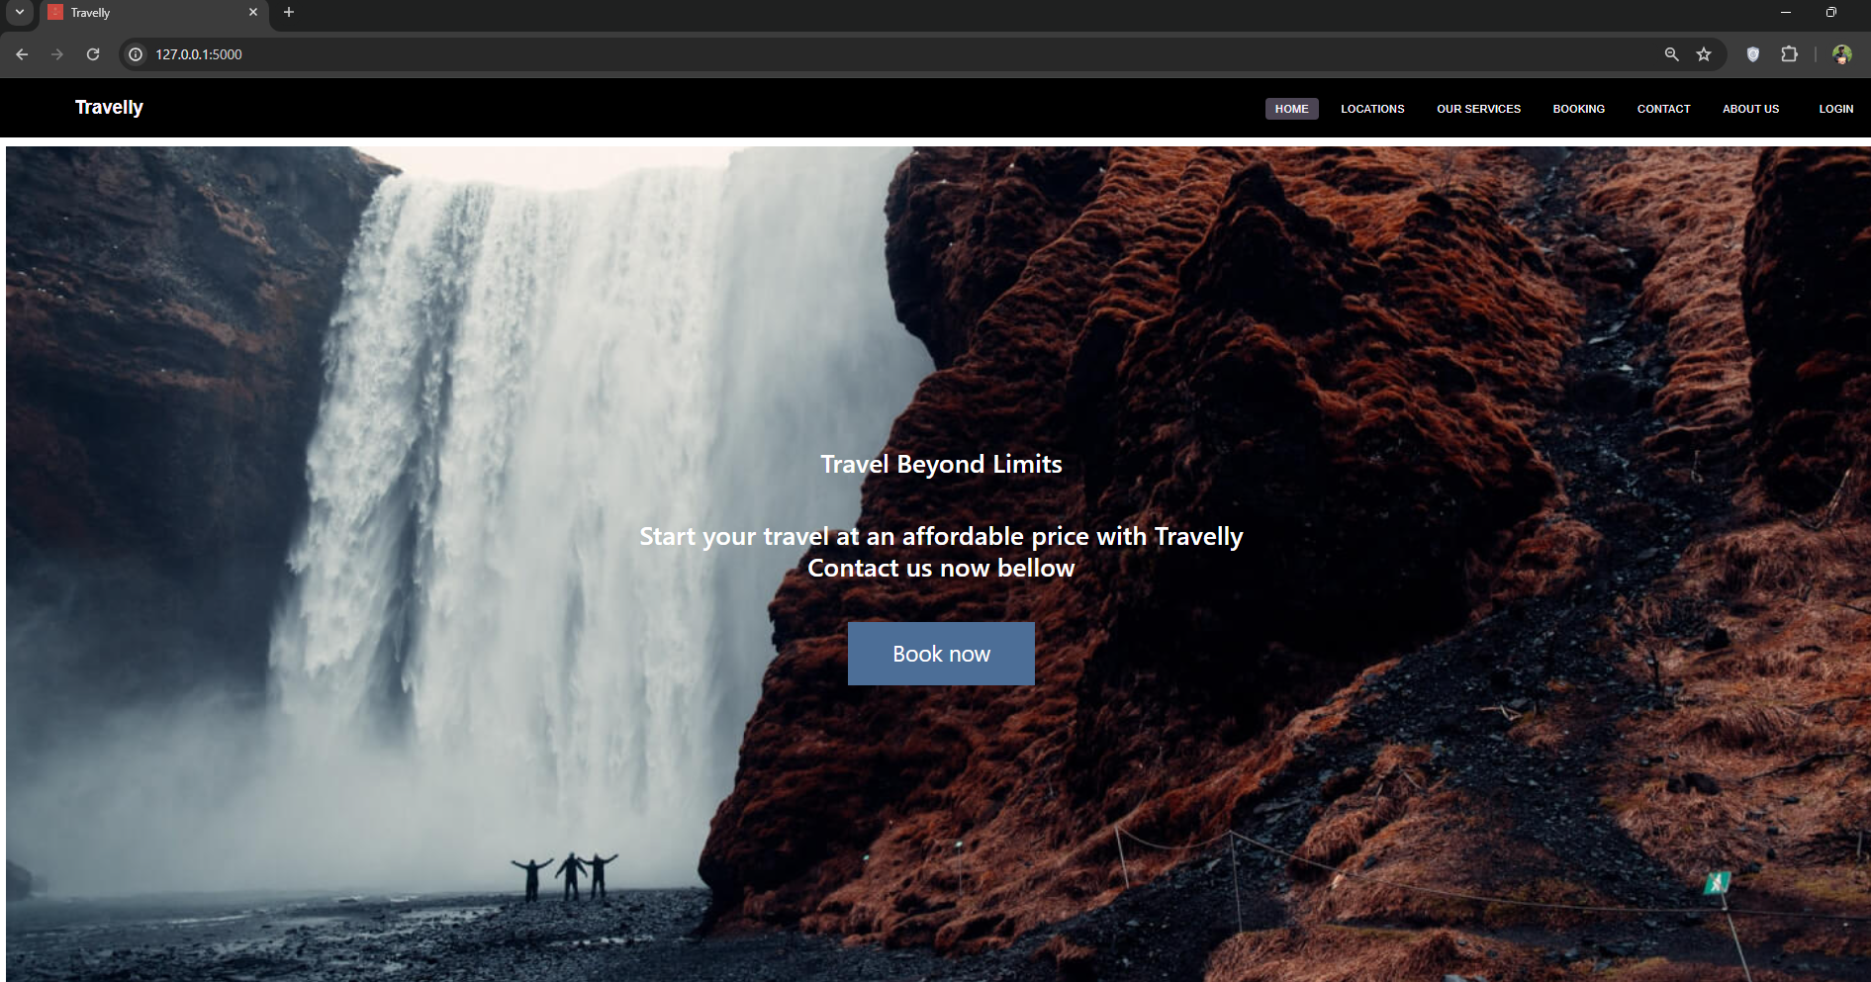
These is my home page that display information of my web site

Slide 7
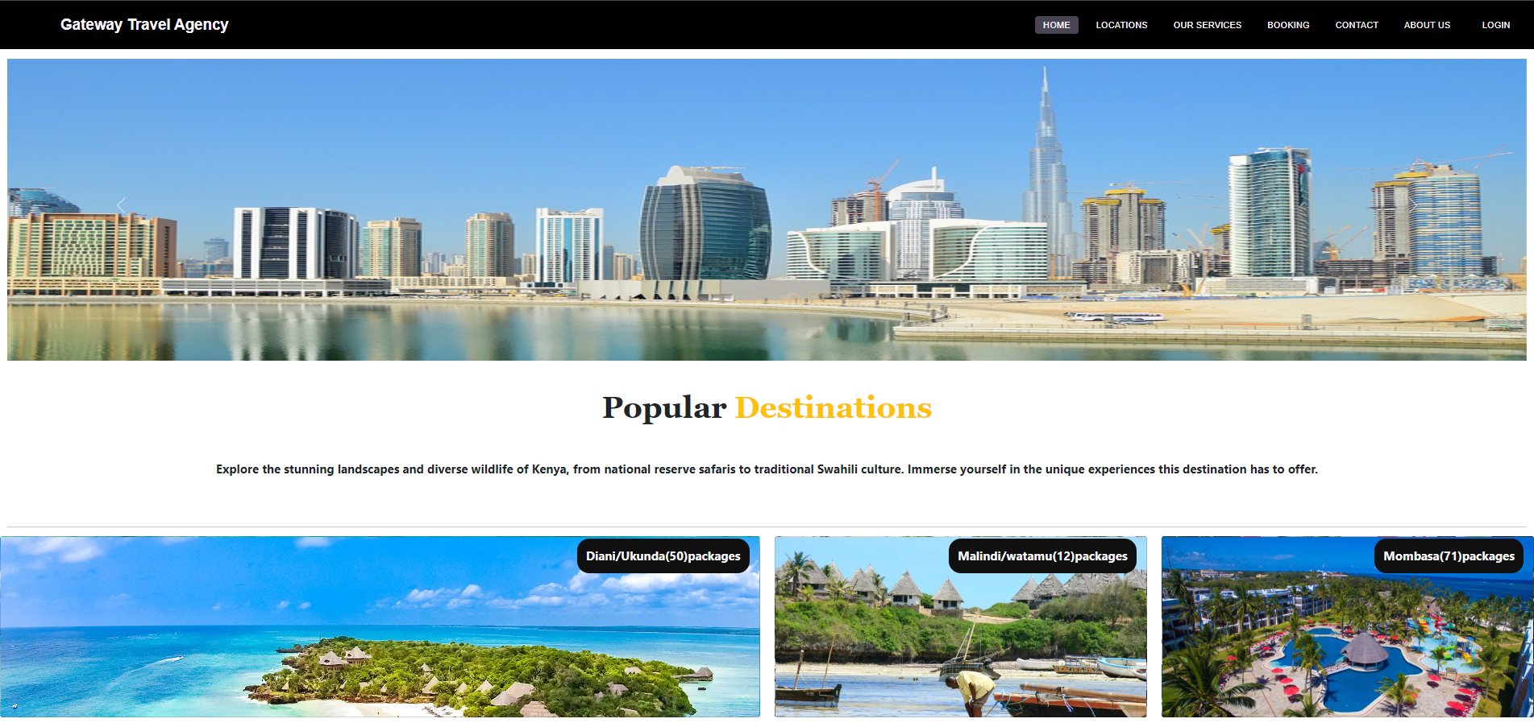
After clicking the book it display more categories of different routs were one can be interested.

Slide 8
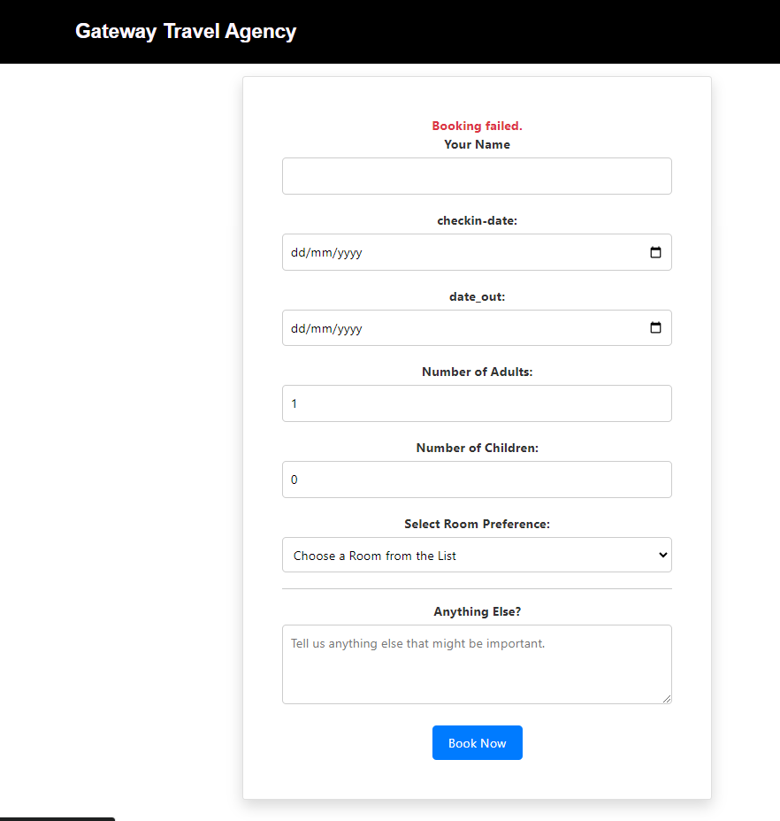
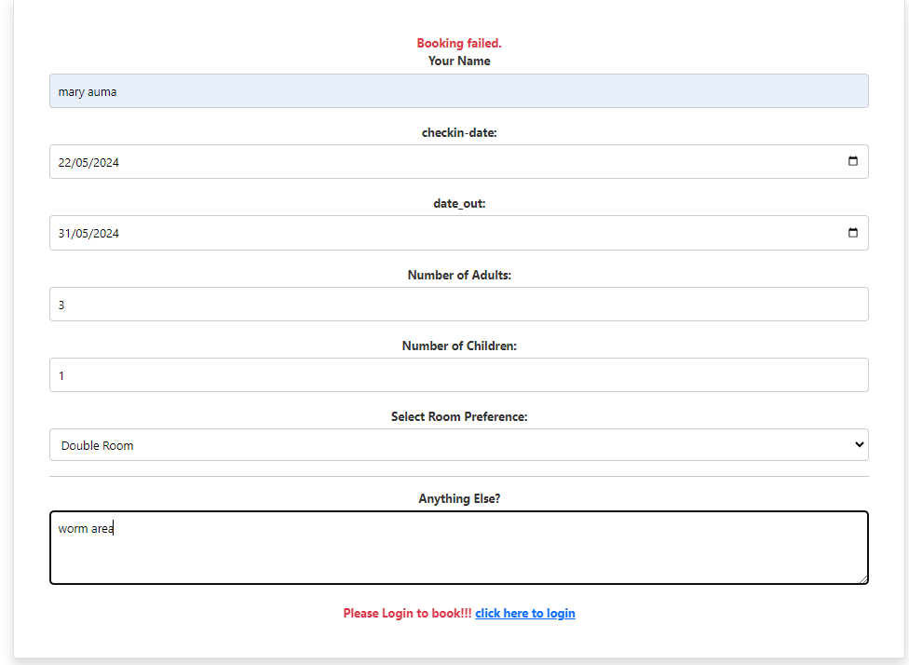
After clicking the your place of chose it display another section were you put your details on how many are going to for the trip.

Slide 9
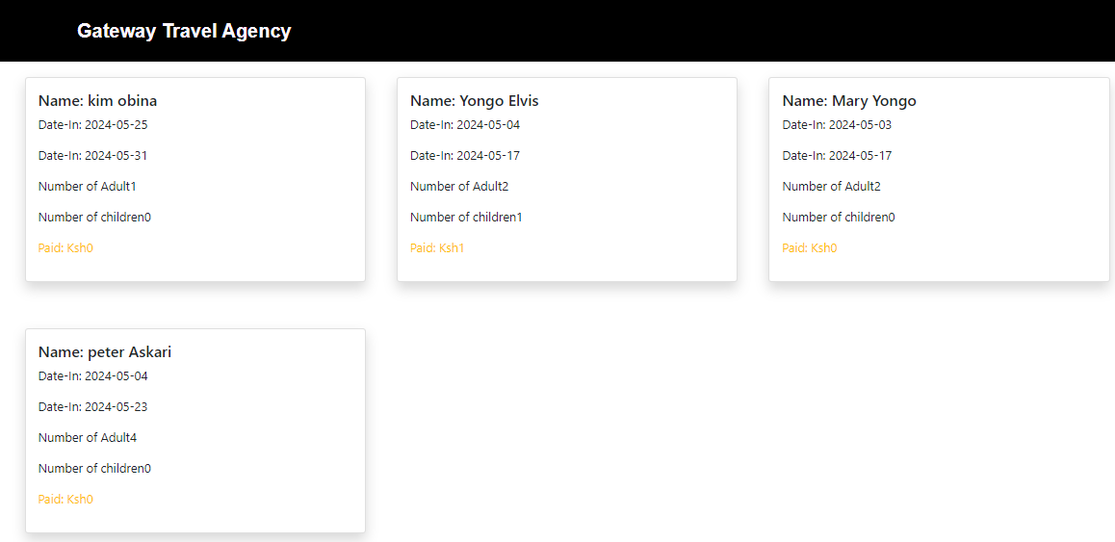
Here the secretary , tour operators and the staff can view who has book made any payments, then he or she can be given the permit as he wanted according to her choice of details provided.

Slide 10
Target Audience
The traveling agency system can be used by various stakeholders such as travelers, travel agents, tour operators, and administrative staff within the agency. Travelers utilize the system to search for and book flights, accommodations, and activities. Travel agents and tour operators manage bookings, handle customer inquiries, and organize travel itineraries. Administrative staff use the system for accounting, reporting, and overall management of the agency's
Explain Any Revenue model you would want to use to make Money. i.e.
partners with travel suppliers to offer their products and services on the site.
The commission rate varies depending on the supplier and the type of product or service being booked Commissions
offer additional services to customers, such as travel insurance, tours, and activities

Slide 11
Conclusion
Gateway Travel Agency is a premier travel booking website that offers a seamless experience for users looking to book and travel to various destinations. Through extensive Research Methodology, Gateway ensures that its platform is user-friendly and caters to the diverse travel needs of customers. By identifying potential issues and challenges proactively, Problem Identification is a key aspect of Gateway's commitment to excellent service. Moreover, a comprehensive Feasibility Study underpins the agency's ability to offer competitive travel packages and promotions. The thorough System Analysis employed by Gateway ensures that the platform operates efficiently, guaranteeing a smooth and reliable booking process for all travelers. With a focus on these critical elements, Gateway Travel Agency stands out as a reliable and customer-centric option for all travel enthusiasts.

Slide 12
Future Enhancements:
Develop a mobile app for the system – For easy access when one just need to download the app and it will temporally stay in her or his phone .
Develop a way of payment through credit cards e.g visa and implement the Mpesa way for payment.
Enhanced Matching Algorithm – were one search history will be looked upon and tell you your most visited site.
We will implement a platform were one can view his bookings after he or she complete everything.
we will implement a way one is able to self drive her self or book car rental if he or she don’t want can book a car rent.

Slide 13
End of presentation.
Thank you for your time.

